Slide 1

AL-FARABI KAZAKH NATIONAL UNIVERSITY
Department of political science and political technologies
Globalization and Development of the Modern World
Abzhapparova A.A.
Senior lecturer

Slide 2
Globalization and Development of the Modern World
Lecture 7
Access to Energy and raw materials

Slide 3
Lecture plan:
  Role of Energy and Raw materials
  Global energy problem
  Possible solutions of global energy problem

Slide 4
The purpose of studying the topic :
To learn:
  the problem of energy and raw material access;
  Causes and result of global energy problem;
  Possible solutions.

Slide 5
Raw materials
Raw materials are natural resources found on or in the earth or seas.
All manufacturing starts with raw materials. These materials are of two basic types, they are renewable or exhaustible.

Slide 6
  Global energy problem
  The emergence of global problems, being the result of contradictions of social development have not arisen-suddenly and only today. Some of them, such as the problems of war and peace, health, existed before, were relevant at all times. Other global problems, such as environmental problems, appear later in connection with the intensive impact of society on the natural environment, and the energy problem appeared not so long ago, after mankind reached the threshold of nuclear energy. But today in the world fuel while is extracted, power plants work non-stop and the world economy functions in the accelerating mode, however the power problem remains one of the most acute.

Slide 7
THE CONCEPT OF ENERGY
“Energy can be described as the capacity to do work.”
“Energy can be stored within systems in various forms.”
“Energy can be converted from one form to another and transferred between systems.”
“The total amount of energy is conserved in all conversions and transfers.”
Source: Jussi Maunuksela (2012)

Slide 8
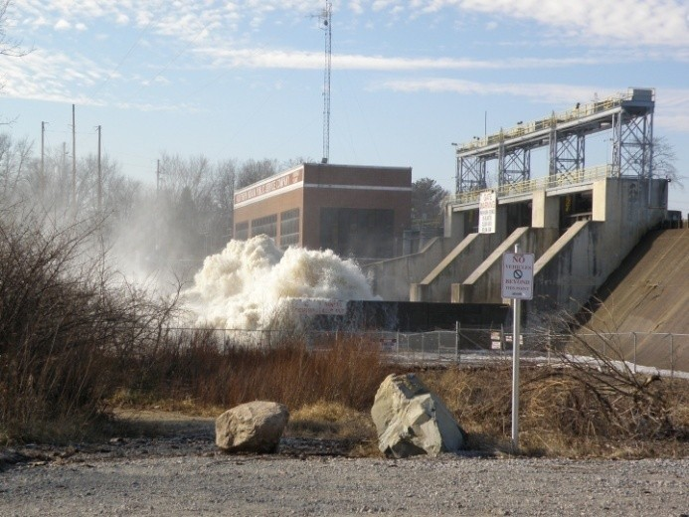

The concept of energy helps us to describe many processes in the world around us.
Electrical Energy
Falling water releases stored “gravitational potential energy” turning into a “kinetic energy” of motion. This “mechanical energy” can be used to spin turbines and alternators doing “work” to generate electrical energy.
Chemical Energy
Burning gasoline in car engines converts “chemical energy” stored in the atomic bonds of the constituent atoms of gasoline into heat that then drives a piston. With gearing and road friction, this motion is converted into the movement of the automobile.
Photo by Hammer51012 on Flickr
Photo by C. Frank Starmer
Source: Jussi Maunuksela (2012)

Slide 9
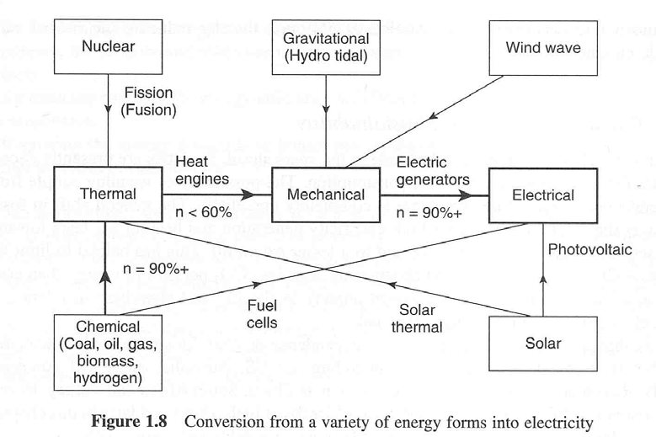
Energy consumption is conversion of energy forms into another.
Conservation of energy principle
Energy can change from one form to another but the total amount remains constant.
Different forms of energy
Mechanical energy Gravitational potential energy Kinetic energy (thermal energy) Magnetic energy
Electrical energy Radiation energy Nuclear energy Chemical energy
Figure from Freris & Infield “Renewable Energy in Power Systems” 2008
Source: Jussi Maunuksela (2012)

Slide 10
Energy consumption is conversion of energy forms into another.
Conservation of energy principle
Energy can change from one form to another but the total amount remains constant.
Different forms of energy
Mechanical energy Gravitational potential energy Kinetic energy (thermal energy) Magnetic energy
Electrical energy Radiation energy Nuclear energy Chemical energy
Figure from Freris & Infield “Renewable Energy in Power Systems” 2008
Source: Jussi Maunuksela (2012)

Slide 11

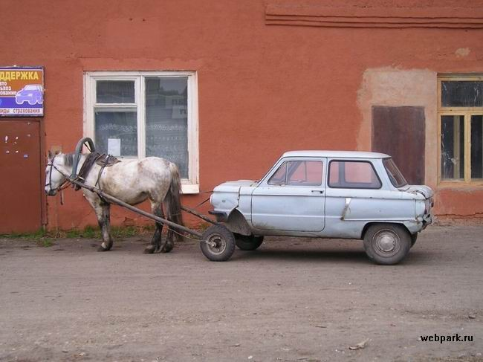
Any serious discussion of energy must be quantitative.
”My car uses very little oil.”
In driving a thousand kilometers, or standing in the garage? Compared with Saudi Arabian exports or with a horse?
Photo by Albert Bridge
Requirements for comparing quantities
We must be able to measure them, i.e., we need units (l, gallons, tons). We must know which type of quantity we are discussing (l, l/km, l/h).
Source: Jussi Maunuksela (2012)

Slide 12
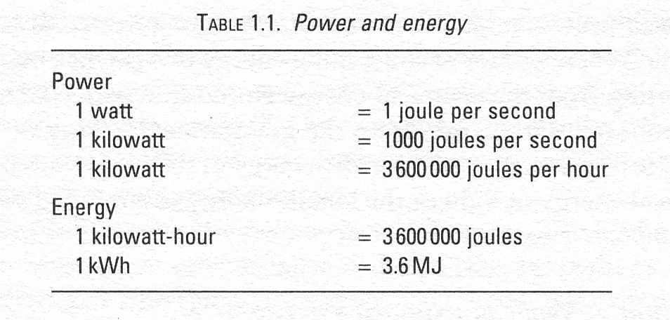
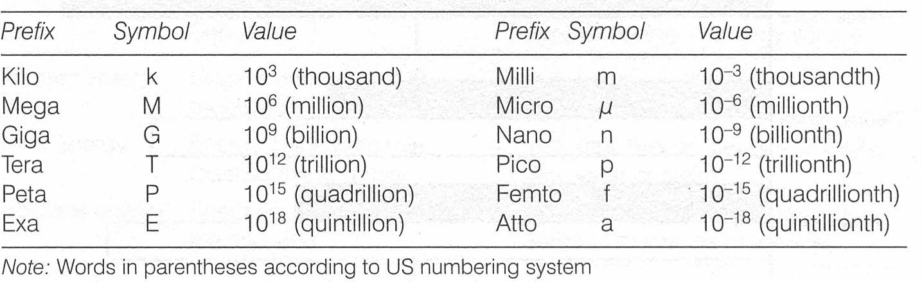
Units and quantities of energy or power are mixed up frequently.
Energy (and work)
joule (J), watt-second (Ws)
Power
joule-per-second (J/s), watt (W)
Source: Jussi Maunuksela (2012)

Slide 13
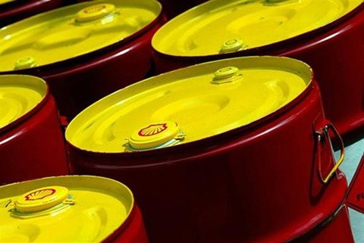
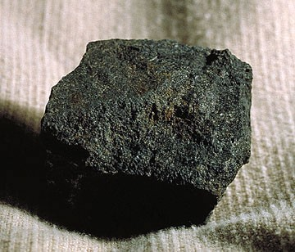
Energies can be expressed as equivalent amounts of oil or coal.
Tonne of oil equivalent (toe)
When oil is burned its chemical energy is converted into heat energy, and 1 toe is simply the heat energy released in burning one tonne of oil.
1 Mtoe ≈ 42 PJ ≈ 12 TWh
Tonne of coal equivalent (tce)
Correspondingly, 1 tce is the heat released in burning one tonne of coal.
1 Mtce ≈ 28 PJ ≈ 7.5 TWh
Source: Jussi Maunuksela (2012)

Slide 14
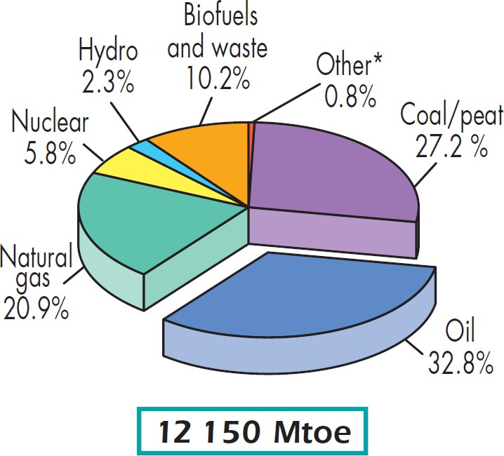
The World present total consumption of primary energy is about 12 150 Mtoe (2009).
Primary energy
The total energy ‘contained’ in the original source before its transformation into other useful forms like electricity.
Main resources
Fossil fuels (coal, oil, natural gas) Biofuels (combustible renewables & waste)
Note:
‘Other’ includes geothermal, solar, wind, heat, etc.
Chart from Key World Energy Statistics 2011 from IEA.
15

Slide 15
The average rate of World primary power consumption is 16 300 GW.
World primary energy consumption
12 267 Mtoe = 515 214 PJ ≈ 515 EJ
World primary energy consumption per capita
12 267 Mtoe / (6,8 x 10⁹) = 1.8 toe
World primary power consumption
515 EJ / (365 h/days x 24 h/day x 60 min/h x 60 s/min)
= 0,0000163 EJ/s = 16 300 GJ/s = 16 300 GW
World primary power consumption per capita
16 300 GW / (6,8 x 10⁹) = 2,40 kW per capita
For example:
Refrigerator’s average rate of power consumption is 12,5-37,5 W.
Source: Jussi Maunuksela (2012)
16

Slide 16
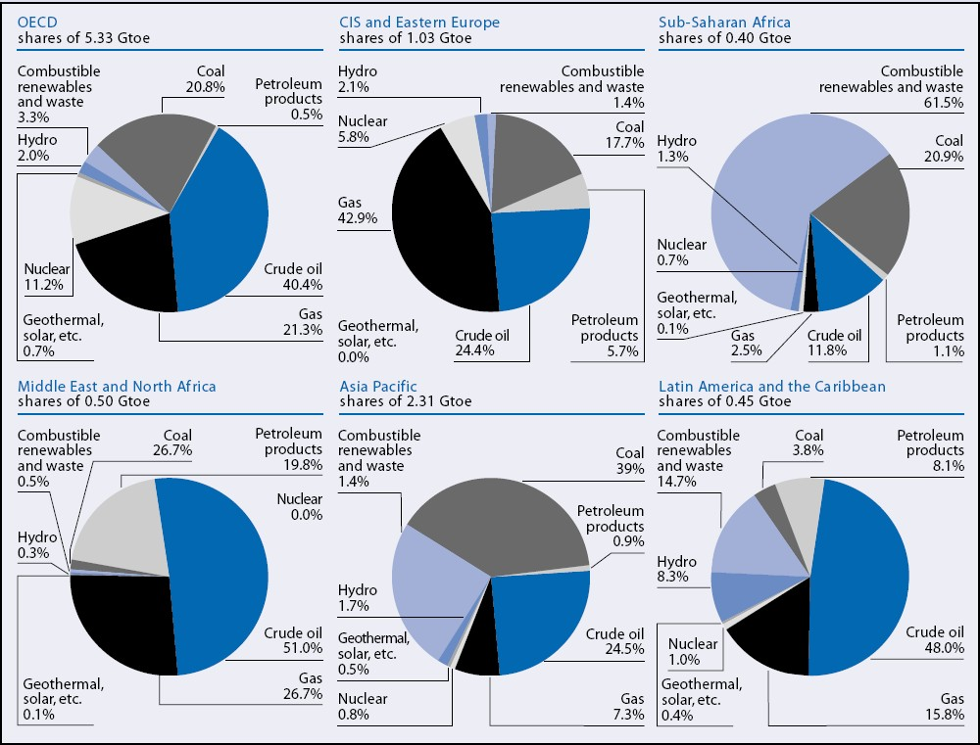
Availability and use of energy around the world is extremely heterogeneous.
Primary energy use in various regions, by energy source, 2001.
Source:
UNDP, World Energy Assessment Overview: 2004 update

Slide 17

Human-made lights highlight developed or polulated areas of the Earth’s surface.
Credit: C. Mayhew & R. Simmon (NASA/GSFC), NOAA/ NGDC, DMSP Digital Archive

Slide 18
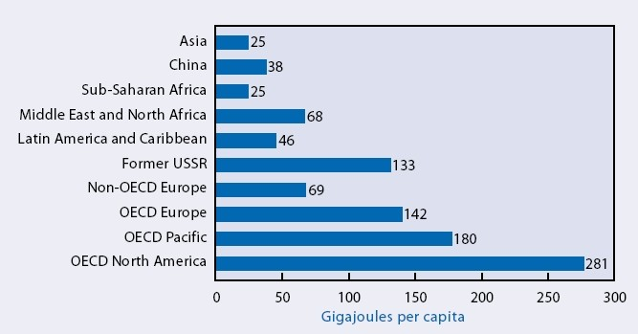
In 2000, per capita use of primary energy in North America was >11 times as much as used by average sub-Saharan African.
Chart from World Energy Assessment Overview: 2004 update
Source: Jussi Maunuksela (2012)
19

Slide 19
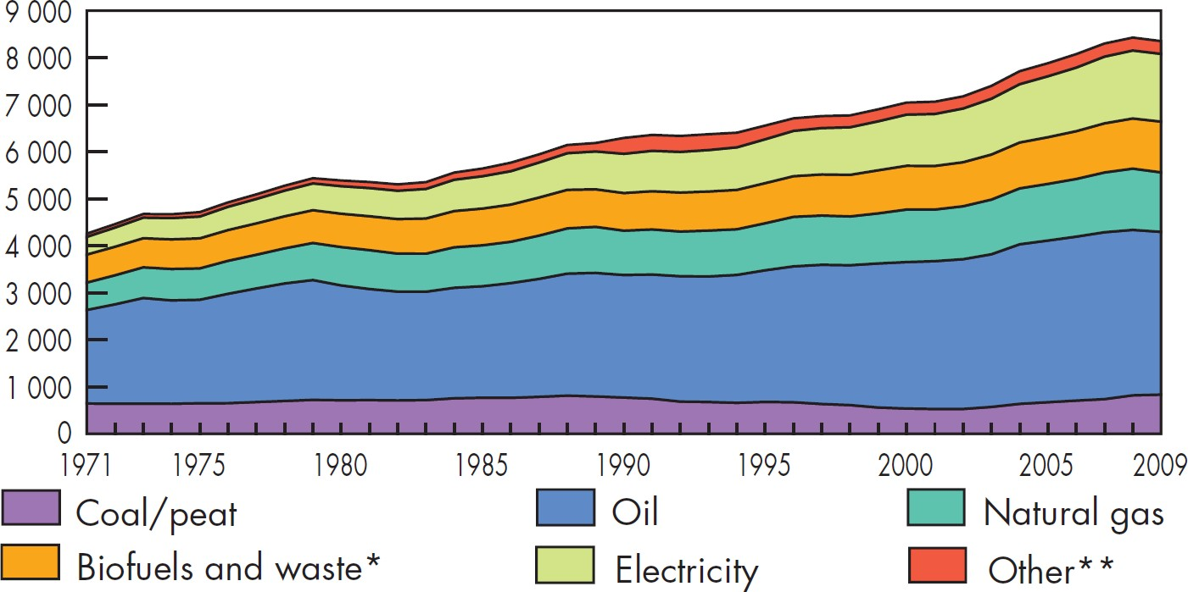
Since 1971, the World total primary energy consumption has grown twice-fold.
Evolution from 1971 to 2009 by fuel (Mtoe)
Chart from the International Energy Agency (IEA) Key World Energy Statistics 2011.
20

Slide 20
Technical conversion of energy has different conversion stages.
Primary Energy
Original energy, not yet processed
E.g. crude oil, coal, uranium, solar radiation, wind
Final Energy
Energy in the form that reaches the end used
E.g. gas, fuel oil, petrol, electricity, hot water or steam
Effective/Useful Energy
Energy in the form used by the end user
E.g. light, radiator heat, driving force of machines or vehicles
Source: Jussi Maunuksela (2012)
21

Slide 21
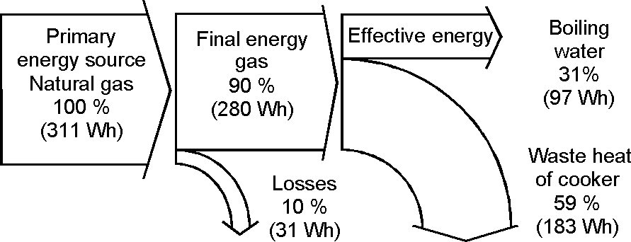
_{Efficiency ≡ η =} profitable energy
The quality of the energy conversion is described by the efficiency.
expended energy
The comparison of energy efficiency should be based on primary energy when considering different energy carriers (gas, electricity).
Source: Volker Quaschning, Understanding Renewable Energy Systems, Earthscan, 2007
22

Slide 22
An energy system is used to deliver to consumers the benefits that energy use offers.
Energy System
An energy system is made up of
an energy supply sector
energy end-use technologies.
Energy Services
The term energy services is used to describe the benefits: Households: illumination, cooked food, comfortable indoor temperatures, refrigeration, etc.
Industry: heating and cooling, motive power, electricity, etc.
Source: Jussi Maunuksela (2012)
23

Slide 23
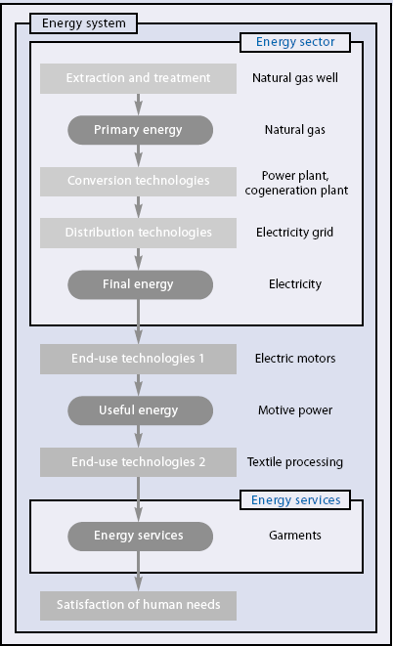
An energy chain consists of energy supply sector, energy end-use technologies, and energy services.
E.g. energy chain beginning with natural gas extracted from a well (primary energy) and ending with produced garments as an energy service is shown on the right.
Source: UNDP, World Energy Assessment Overview: 2004 update, 2004
24

Slide 24
In most official statistics human activity is divided into four main end-use sectors.
Industry
Manufacturing, iron and steel, food and drink, chemicals, building, agriculture, etc.
Households
Domestic sector
Services
Government buildings, commercial offices, education, health, shops, restaurants, commercial warehouses, etc.
Transportation
Road, rail, air and water transport.
Source: Jussi Maunuksela (2012)
25

Slide 25
Globally, manufacturing is the biggest consumer of final energy.
Global Final Energy Consumption by Sector, 2005
Other 3 %
Manufac- turing 33 %
Services 9 %
Transport 26 %
Households 29 %
Total final energy consumption: 285 EJ
Source: IEA, Worldwide Trends in Energy Use and Efficiency - Key Insights from IEA Indicator Analysis, 2008
26

Slide 26
What are the driving forces that influence our present energy supply?
Three main drivers can identified:
Environmental Issues
Energy prices and Energy Security
Improvements and Technical Innovations in the use of Renewable Energy Sources
(RES)
Source: Jussi Maunuksela (2012)

Slide 27
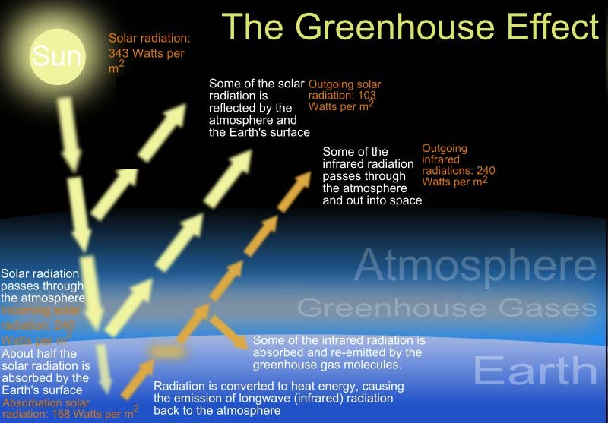
The Earth’s climate is a hugely complex system dependent on many other systems.
CO₂ released from the processing of undergroung stores of fossil fuels is throught to increase the strength of the ‘greenhouse effect’.
Source: From Wikipedia, the free encyclopedia
Source: Jussi Maunuksela (2012)

Slide 28
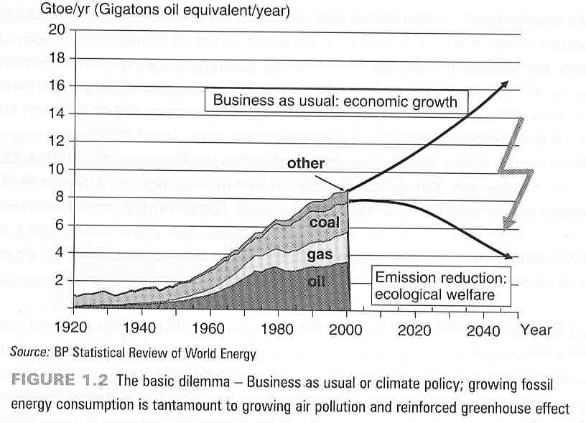
The history of World energy consumption is directly related to the level of GHG emissions.
Economic principles imply that GDP needs to grow each year in order to maintain the living standard of the population.
The main advice to developing countries is to accelerate their economic growth. ⇒ Rising consumption of raw materials and fossil energy.
Source: Jussi Maunuksela (2012)

Slide 29
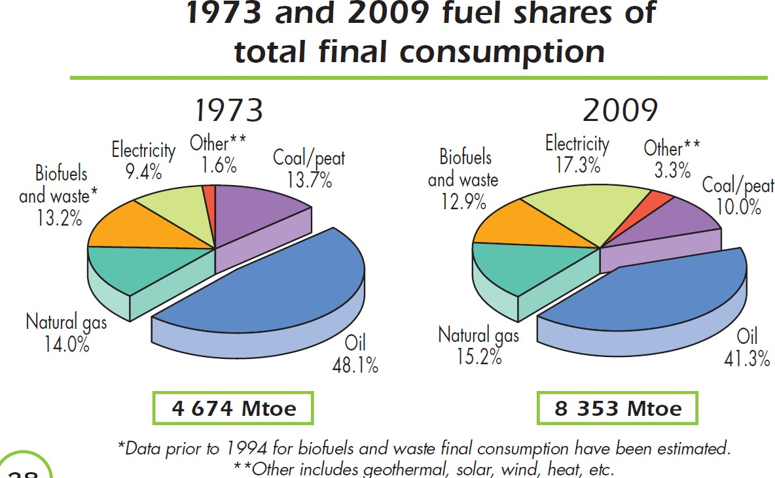
Oil products remain the most important final energy commodity.
Source: Key Energy Statistics 2011 from IEA
30

Slide 30
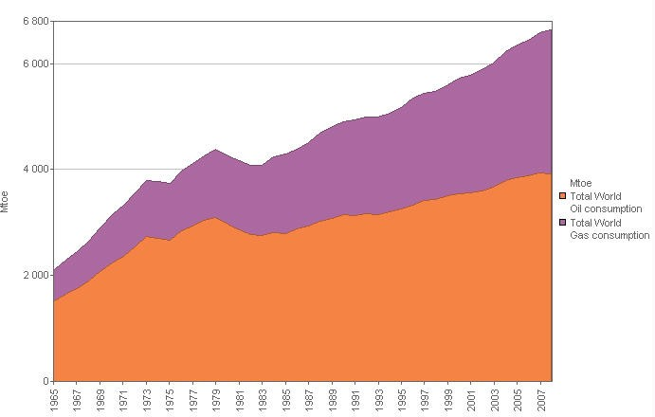
The world demand for oil and gas is increasing significantly each year.
The major part of this increase is currently taken by India and China.
Source: Jussi Maunuksela (2012)

Slide 31
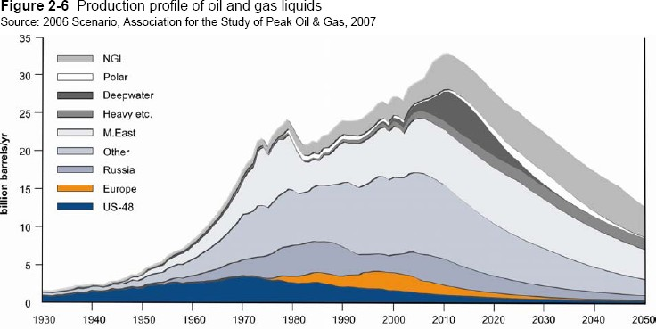
The ultimate availability of fossil fuels is extremely difficult to determine.
2009
Peak oil & gas
Definition: ‘Resources’ are detected quantities that cannot be profitably recovered with current technology, but might be recoverable in the future, as well as those quantities that are geologically possible but yet to be found.
Source: Jussi Maunuksela (2012)

Slide 32
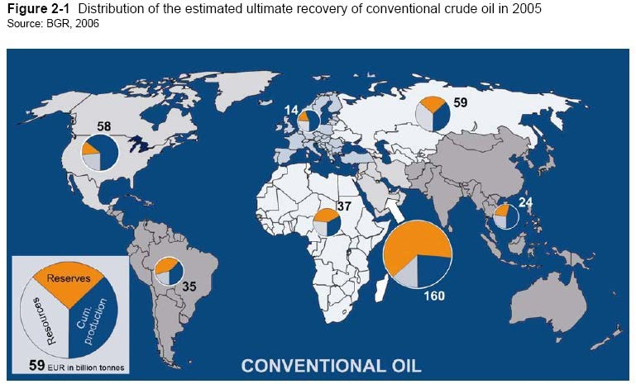
Given the central position of oil in the modern economy, the onset of decline threatens to be a time of great economic and geopolitical tension.
33

Slide 33
Energy resources may be categorised as either finite or perpetual.
Resources / Reserves?
Resources refer to amounts that are known or deduced to be present and potentially accessible.
Reserves denote the amount within the designated finite resource that is recoverable under specified criteria.
Finite Resources
Coal, crude oil, oil shale, natural bitumen and extra-heavy oil, and natural gas, together with the metallic elements (U, Th).
Perpetual Resources
Solar energy, wind energy, bioenergy, tidal energy, wave power and ocean thermal energy conversion (OTEC).
Source: Jussi Maunuksela (2012)

Slide 34
There are two types of energy resource which are to some extent intermediate in nature.
Peat
Peat is part way between the biomass of which it was originally composed and the fossil fuel (coal) that it would eventually become, given appropriate geological conditions.
It is to a cetaing extent ‘Renewable’ since it is still being formed in many parts of the world.
Geothermal
On the one hand, geothermal energy is to a certain extent subject to attrition (individual geothermal wells are liable to decline and eventuallu exhaust).
On the other hand, the supply of geothermal energy can be boosted (e.g. by water-injection).
Source: Jussi Maunuksela (2012)

Slide 35
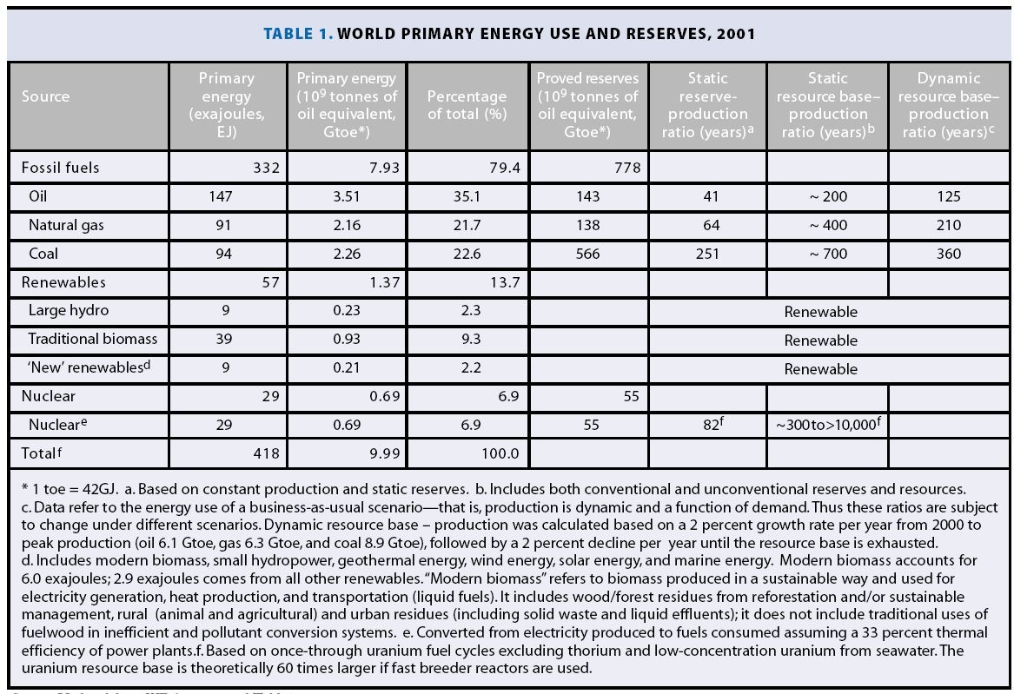
36

Slide 36
Sustainable development meets the needs of the present without compromising the ability of future generations to meet their own needs.
Options for using energy in ways that support sustainable development include:
More efficient use of energy, especially at the point of end use in buildings, transportation, and production processes.
Increased reliance on renewable energy sources.
Accelerated development and deployment of new energy technologies.
Source: Jussi Maunuksela (2012)

Slide 37
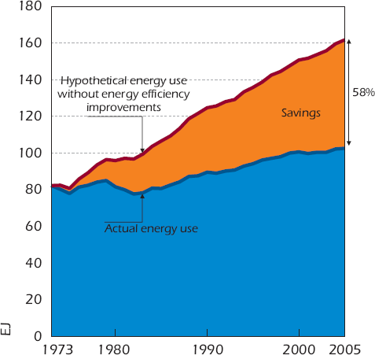
Savings from improved energy efficiency are significant.
Without the energy efficiency improvements that occurred between 1973 and 2005, energy use in the IEA11 would have been 58%, or 59 EJ, higher in 2005 than it actually was.
Source: IEA, Worldwide Trends in Energy Use and Efficiency - Key Insights from IEA Indicator Analysis, 2008
Source: Jussi Maunuksela (2012)

Slide 38
Ways to solve the raw materials and energy problems
  Decline in production
  Use of alternative energy sources
  Increased production and production efficiency
  Use and improvement of treatment devices.

Slide 39
Materials used in the lecture :
1. С.Л. Удовик. Глобализация: семиотические подходы–М.: “Реф л-бук”, К.: “Ваклер”, 2001. – 480 с.
2. Глобализация и интеграционные процессы в Азиатско-Тихоокеанском регионе (правовое и экономическое исследование). - М.: ИНФРА-М, 2016. - 332 c.
3. Andrew Heywood. Global Politics. Macmillan International Higher Education, 2017 – 616 p.
4. Sheffield Jim, Korotaev Andrey, Grinin Leonid. Globalization: Yesterday, Today, and Tomorrow. Emergent Publication, 2013. — 444 p.
5. Gills, B. K., and Thompson, W. R. (eds.) 2006. Globalization and Global History. London: Routledge.

